Slide 1
WELCOME TO THE SPORTS CENTRE

Slide 2
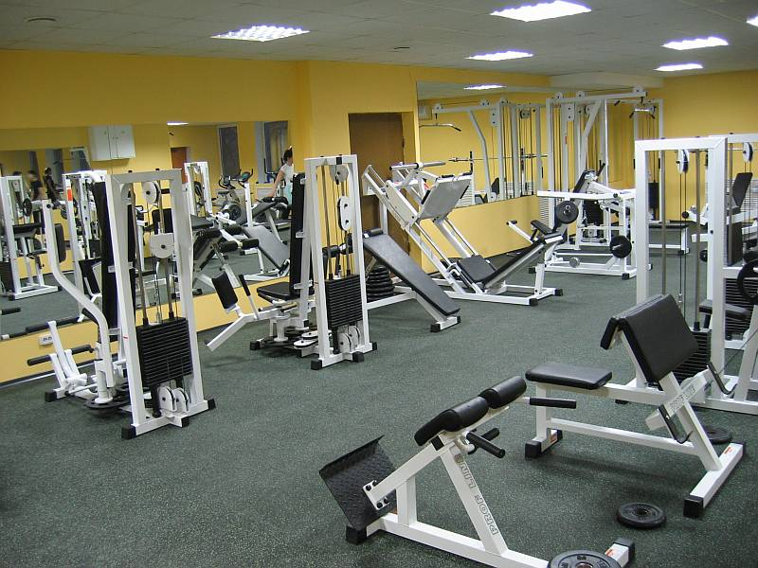
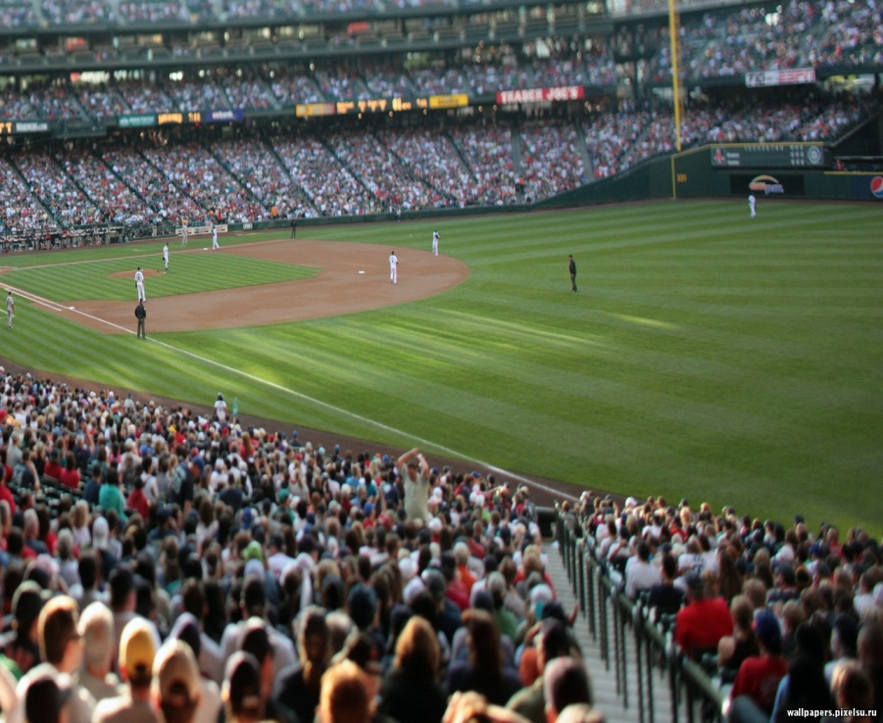
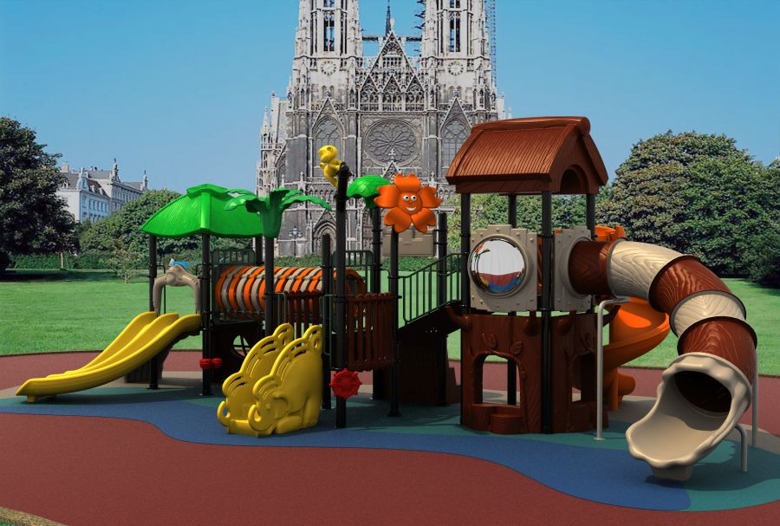
Room #2
Room # 1
Room # 3
Room # 4

Slide 3
jump
skip
dance
Gym
run
play table tennis

Slide 4
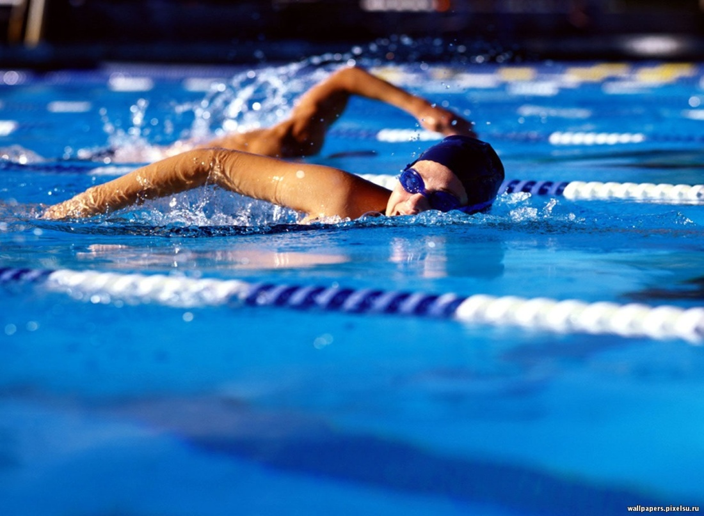
Room #2
Room # 3
Room # 4

Slide 5
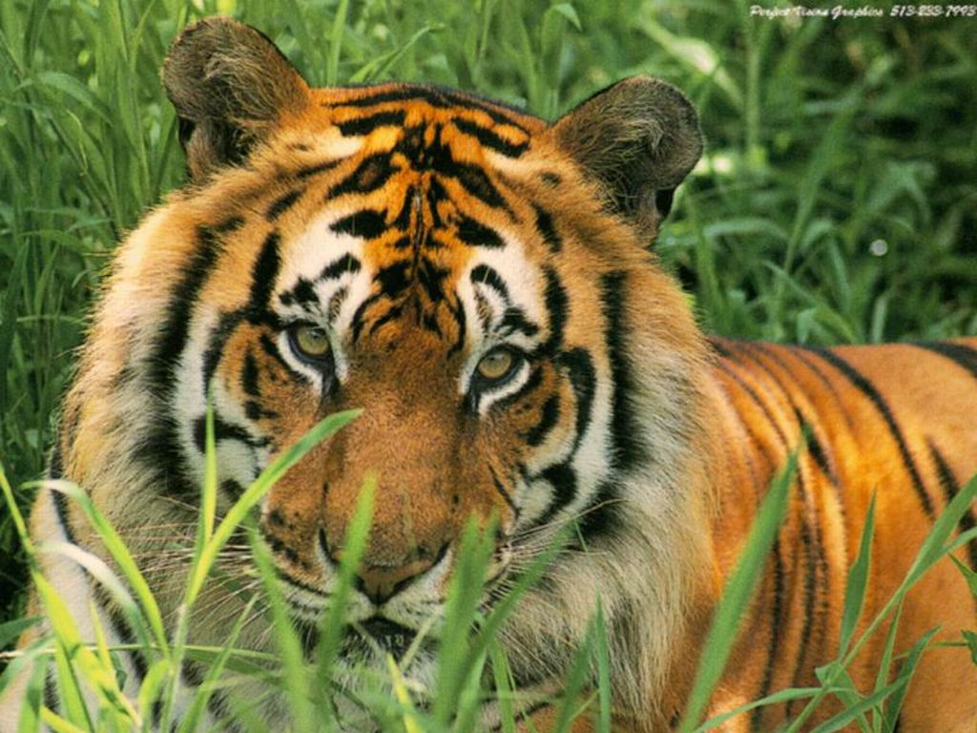
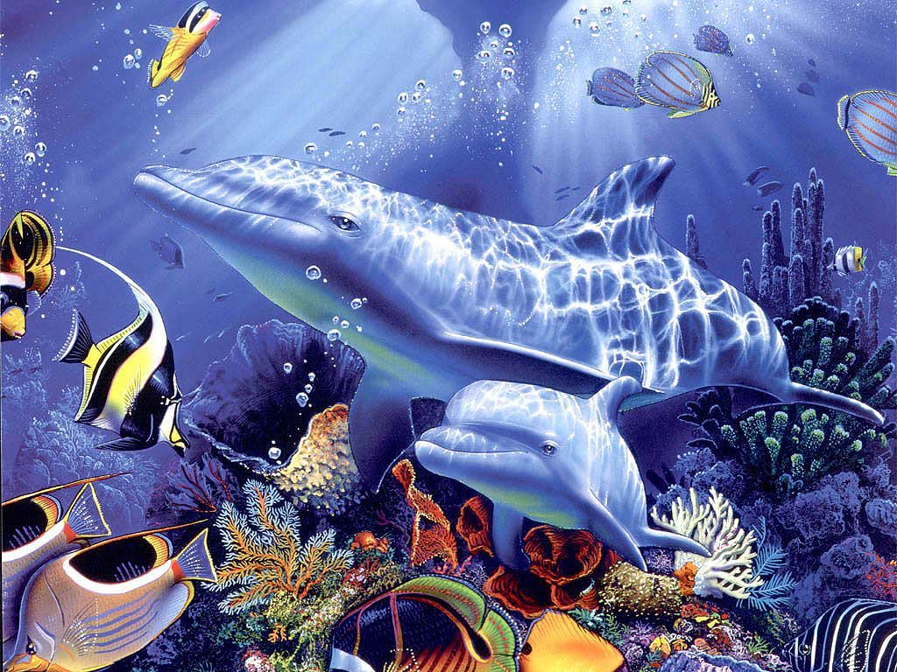
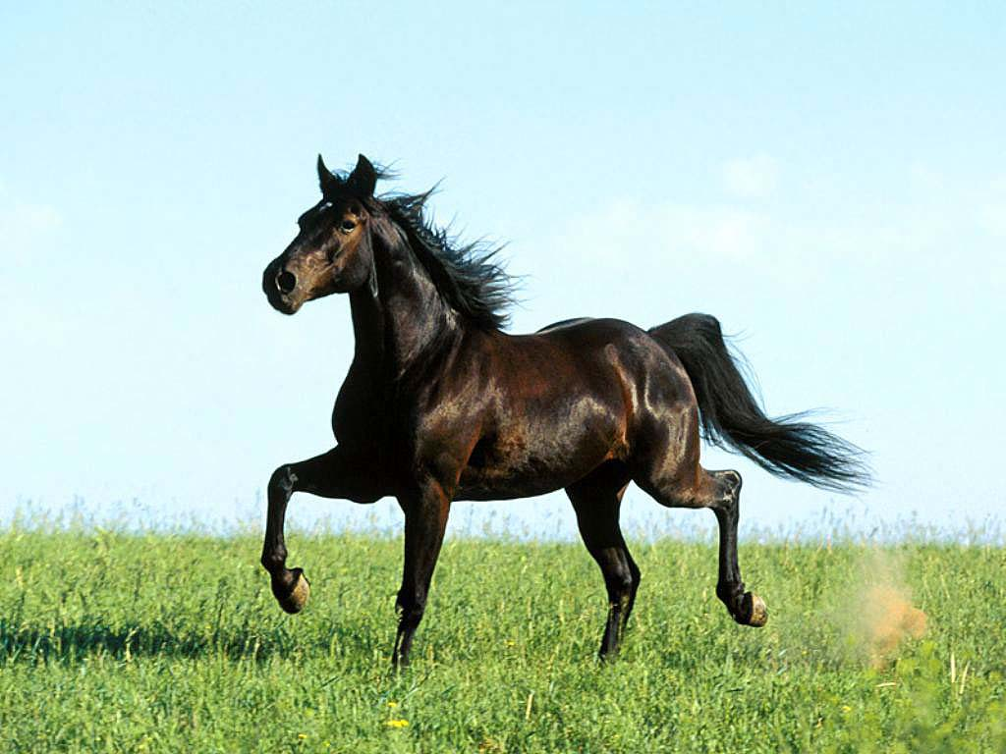
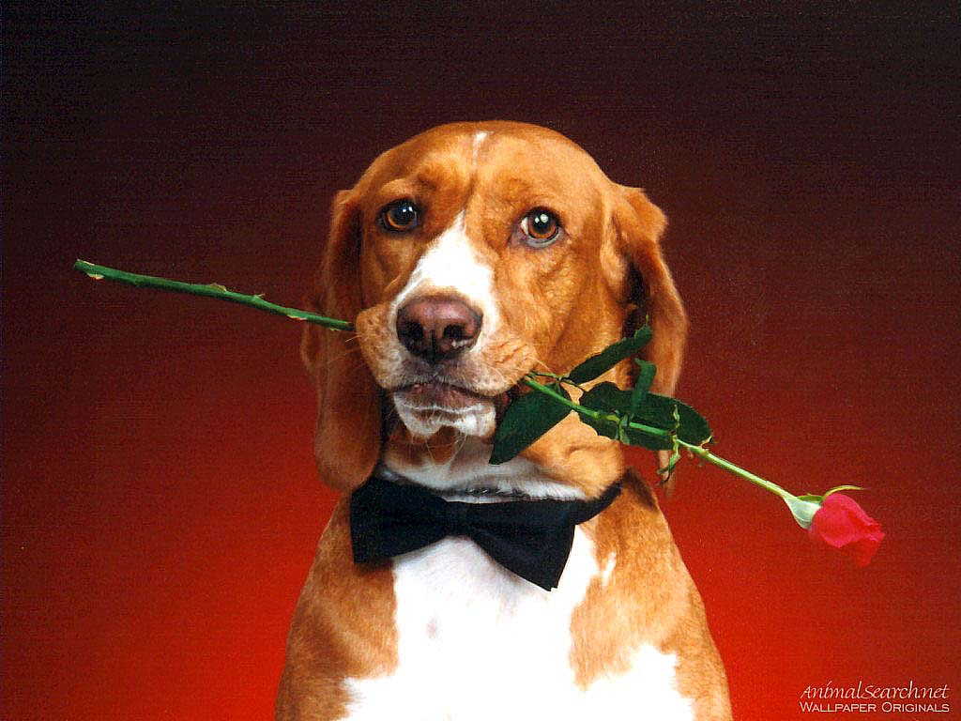
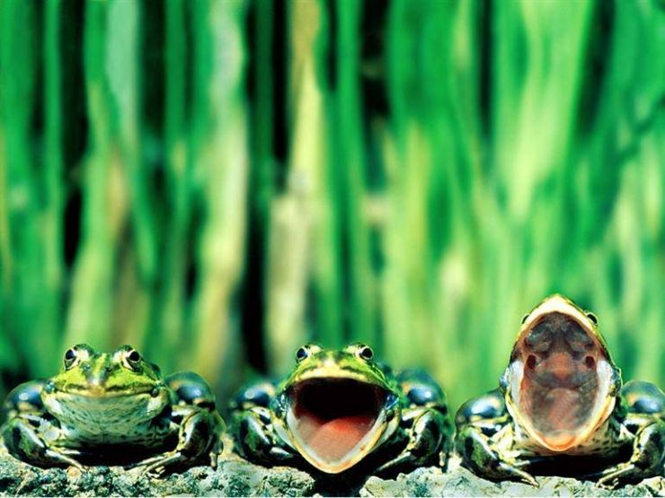

Slide 6
I have got a horse. His name is Harry. He is 3. He is from Russia. He can run, jump and swim very well.

Slide 7
Room # 3
Room # 4

Slide 9
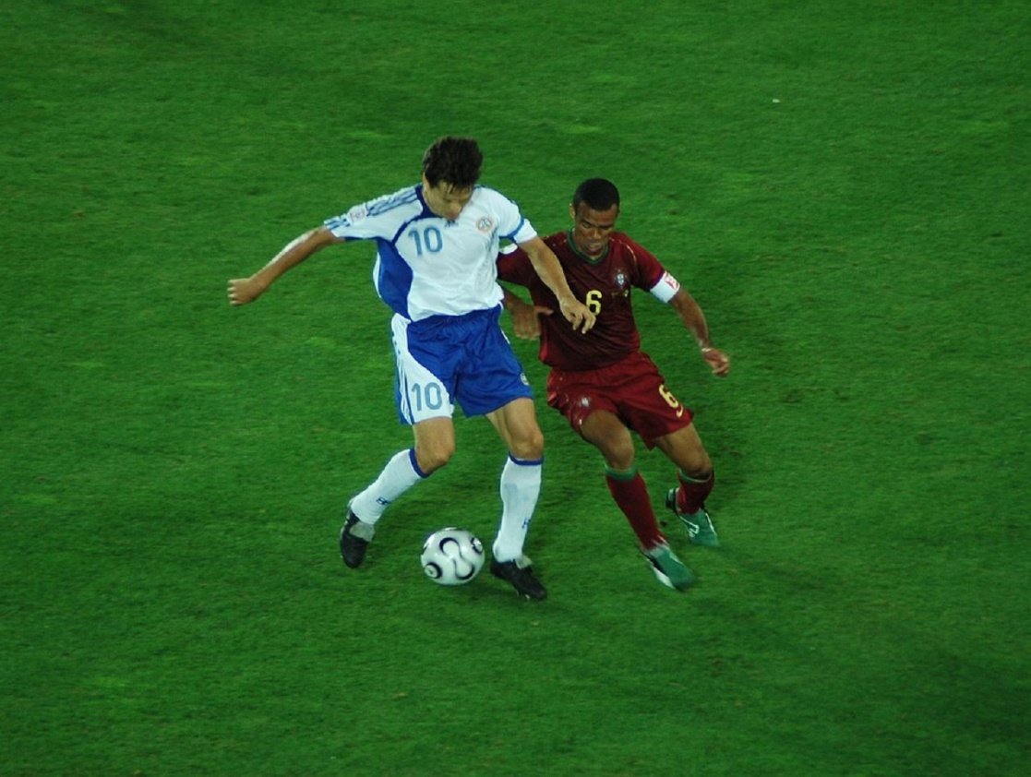
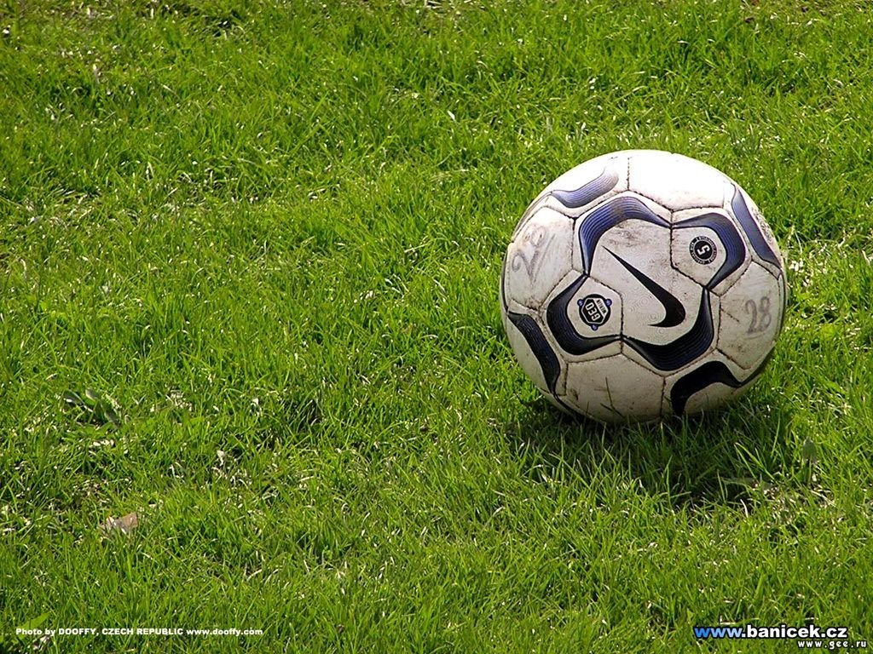
Football Match
Hooray!
Hooray!

Slide 10
Can you..?
Yes, I can.
No, I can’t.

Slide 11
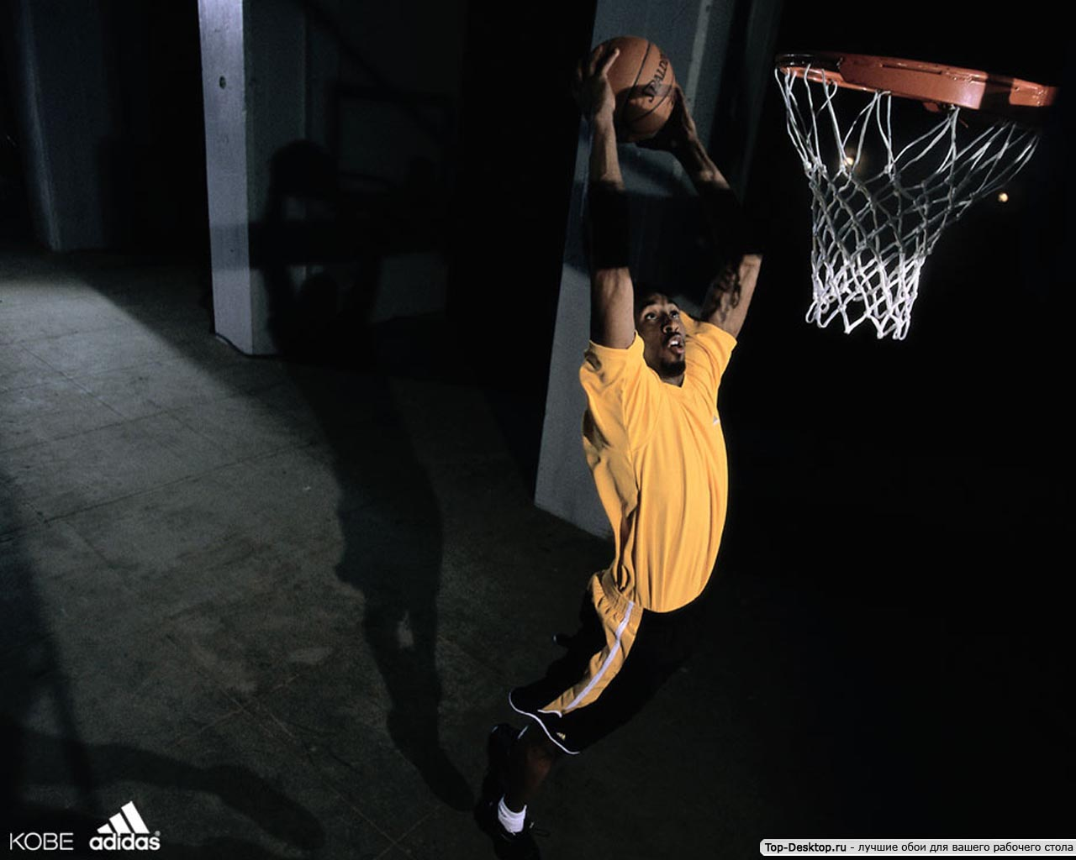
Room # 4
Room # 4

Slide 12
On the sports ground
play basketball
play tennis
play baseball
ride a bike

Slide 13
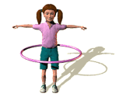
A sound mind is a sound body

Slide 14
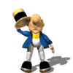
Thank you for your work!

